Slide 1
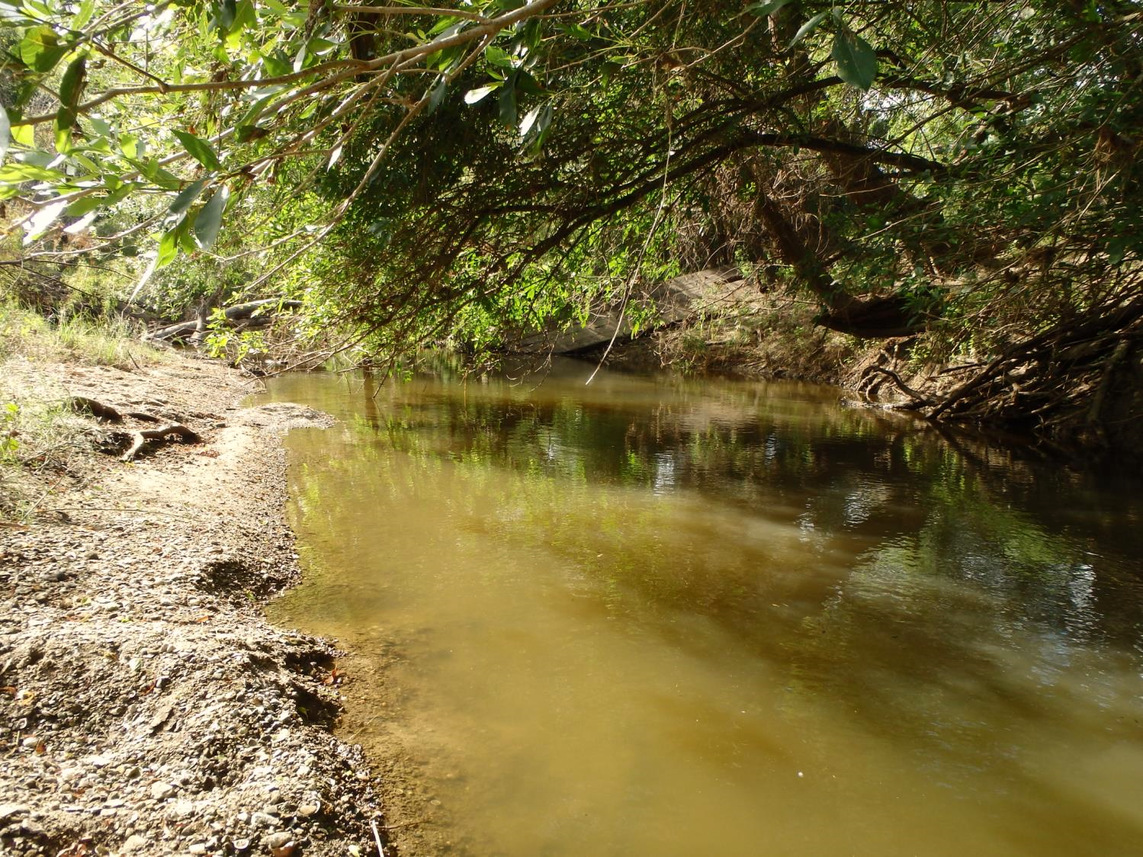
Recreational Use Changes
Surface Water Quality Standards Advisory Workgroup
March 2020
Kate Lavelle
Notes:
This is a presentation on Draft Recreational Use Changes in the 2021 Texas Surface Water Quality Standards

Slide 2
Recreational Use-Attainability Analysis
What is a Recreational Use-Attainability Analysis (RUAA)?
Study required to make a change to a water body’s recreation use and associated criterion in the Texas Surface Water Quality Standards (TSWQS)
Purpose of a RUAA is to determine the appropriate recreational category and associated bacteria criterion for a water body
Notes:
RUAA is a study required to make a change to a water body’s recreation use and associated criterion. The purpose of these studies is to determine the appropriate recreational category and associated bacteria criterion for a water body. Water bodies in the state of Texas have a presumed or designated use of primary contact recreation, with the exception of some water bodies that have a noncontact recreation designation or a site-specific secondary contact recreation use. Rita Blanca Lake has NCR that is not related to unsafe conditions due to ship or barge traffic. Cartoon images of swimming and fishing.

Slide 3
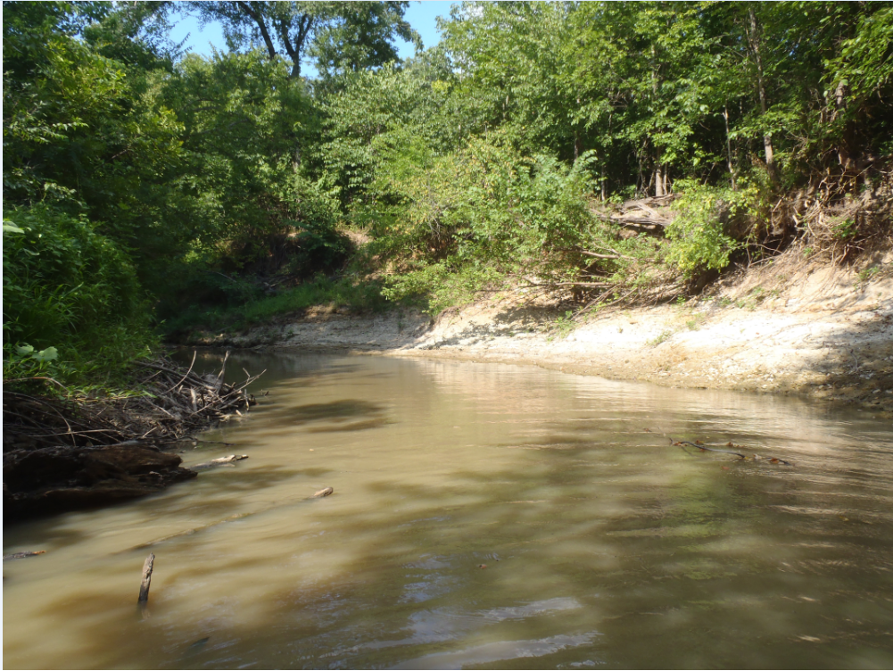
Recreational Use-Attainability Analysis
RUAA document:
Current levels of recreation use – interview stakeholders, field observations
Physical measurements of the stream (depth, width, etc.)*
Potential for flow and habitat characteristics to support recreation
Proximity to parks and residential areas
Historical recreation use
*conducted during warm weather
Notes:
RUAAs document current and historical recreation use through interviews with stakeholders and historical information review. We document physical measurements of the stream and the potential for flow and habitat to support recreation. We also document the proximity to parks, residential areas, and public access from roadways. These studies are conducted during warm weather when water flow is most likely to support recreation and when recreation is most likely to occur.
Cartoon image of a swimmer.

Slide 4
2010 Contact Recreation Standards: Freshwater
Recreation Category | Definition Summary | Geometric Mean Criteria (CFU*/100 mL)
Primary Contact | Significant risk of ingestion (swimming, wading by children, tubing, etc.) | 126
Secondary Contact 1 (SCR 1) | No significant risk of ingestion (fishing, boating, etc.) | 630
Secondary Contact 2 (SCR 2) | Same as SCR 1, but recreational activities occur less frequently because of physical characteristics or limited public access | 1030
Noncontact Recreation (NCR) | No significant risk of ingestion and contact recreation does not occur because of unsafe conditions (ship and barge traffic, birding, etc.) | 2060
*CFU = colony forming units
Notes:
These are the 2010 contact recreation standards. Primary contact recreation is appropriate for activities that involve a significant risk of ingestion such as swimming, tubing or wading by children. SCR 1 is for activities where there is no significant risk of ingestion such as fishing or boating. SCR 2 includes the same activities as SCR 1 but they are expected to occur less frequently due to physical characteristics of the water body. Noncontact applies to water bodies where activities do not involve a significant risk of water ingestion, such as birding, hiking, biking, or where there is no contact recreation because of unsafe conditions.
CFU is the unit for measuring bacteria. It stands for colony forming units.

Slide 5
2014 Contact Recreation Standards: Freshwater Pending EPA Review
Recreation Category | Definition Summary | Geometric Mean Criteria (CFU*/100 mL)
Primary Contact 1 (PCR 1) | Significant risk of ingestion (swimming, wading by children, tubing, etc.) | 126
Primary Contact 2 (PCR 2) | Same activities as PCR 1 but occur less frequently than PCR 1 due to (A) physical characteristics of the water, or (B) limited public access | 206
Secondary Contact 1 (SCR 1) | No significant risk of ingestion (fishing, boating, etc.) | 630
Secondary Contact 2 (SCR 2) | Same as SCR 1, but recreational activities occur less frequently because of physical characteristics or limited public access | 1030
Noncontact Recreation (NCR) | No significant risk of ingestion and contact recreation does not occur because of unsafe conditions (ship and barge traffic, birding, etc.) | 2060
*CFU = colony forming units
Notes:
These are the 2014 contact recreation standards. The 2014 recreation standards include primary contact recreation 2 (PCR 2) which has a corresponding geomean of 206 cfu and applies for the same activities as PCR 1 but when these activities occur less frequently due to physical characteristics of the stream or limited public access. PCR 2 is pending EPA review.

Slide 6
Draft Recommendations for Recreational Use Changes Appendix A
Primary contact recreation 1
1241 | Double Mountain Fork Brazos River
1412 | Colorado River Below Lake J.B. Thomas
Secondary contact recreation 1
0207 | Lower Prairie Dog Town Fork Red River
2108 | San Miguel Creek
Notes:
Recreation use was evaluated on four classified water bodies. This slide shows the recommendations for recreation use changes (secondary contact recreation 1) to two unclassified segments that will go in appendix A of the Texas Surface Water Quality Standards. Two classified segments would retain their designated primary contact recreation use. A cartoon image of a canoe.

Slide 7
Draft Recommendations for Recreational Use Changes Appendix G
Primary contact recreation 1
1222C | Sabana River
1602B | Rocky Creek*
2453C | Arenosa Creek
* Rocky Creek recommendation already released for public comment
Secondary contact recreation 1
0303B | White Oak Creek
0409B | South Lilly Creek
0501B | Little Cypress Bayou
1412B | Beals Creek
Notes:
This slide shows the recommendations for recreation use changes (secondary contact recreation 1) to four unclassified water bodies that will go in appendix G of the Texas Surface Water Quality Standards. These water bodies have a presumed primary contact recreation use. Water bodies with site-specific secondary contact recreation uses or noncontact recreation uses are added to Appendix G of the standards. Three of these water bodies would retain primary contact recreation use.
A recommendation for Rocky Creek has already been released for public comment.
Cartoon images of swimming and fishing.

Slide 8
Instructions for Submitting Comments
Draft recommendations on these recreational use-attainability analyses are available on TCEQ’s website: www.tceq.texas.gov/waterquality/standards/ruaas/index#recommendations-for-public-comment
There will be a 30 day public comment period closing on April 28, 2020*.
Comments can be submitted via email to standards@tceq.texas.gov or by mail to: Katherine Lavelle, TCEQ MC-234, P.O. Box 13087, Austin, TX 78711.
TCEQ will not issue a formal response to the comments at this stage. There will be another comment period after the recommendation on recreational use has been formally proposed by TCEQ.
* Excludes Rocky Creek because it was previously released for public comment.
Notes:
Ten draft recommendations will be available for public comment, excluding Rocky Creek as mentioned earlier. The recommendations and reports are available on the TCEQ RUAA website. The public comment period will end on April 28, 2020. Please submit comments by mail or by email to the addresses listed in the slide. These instructions will also be available on the TCEQ RUAA webpage, and the handout associated with this presentation. The draft recommendations, instructions for submitting public comments and reports associated with the water bodies mentioned are all available on the TCEQ RUAA website.
The TCEQ will not issue a formal response to the comments at this stage. There will be another public comment period after recreational use changes have been formally proposed by TCEQ.

Slide 9
Contact Information
Kate Lavelle
katherine.lavelle@tceq.texas.gov
Aquatic Scientist
Water Quality Standards
512 • 239 • 6011
Notes:
Contact information for the speaker.

